Slide 1

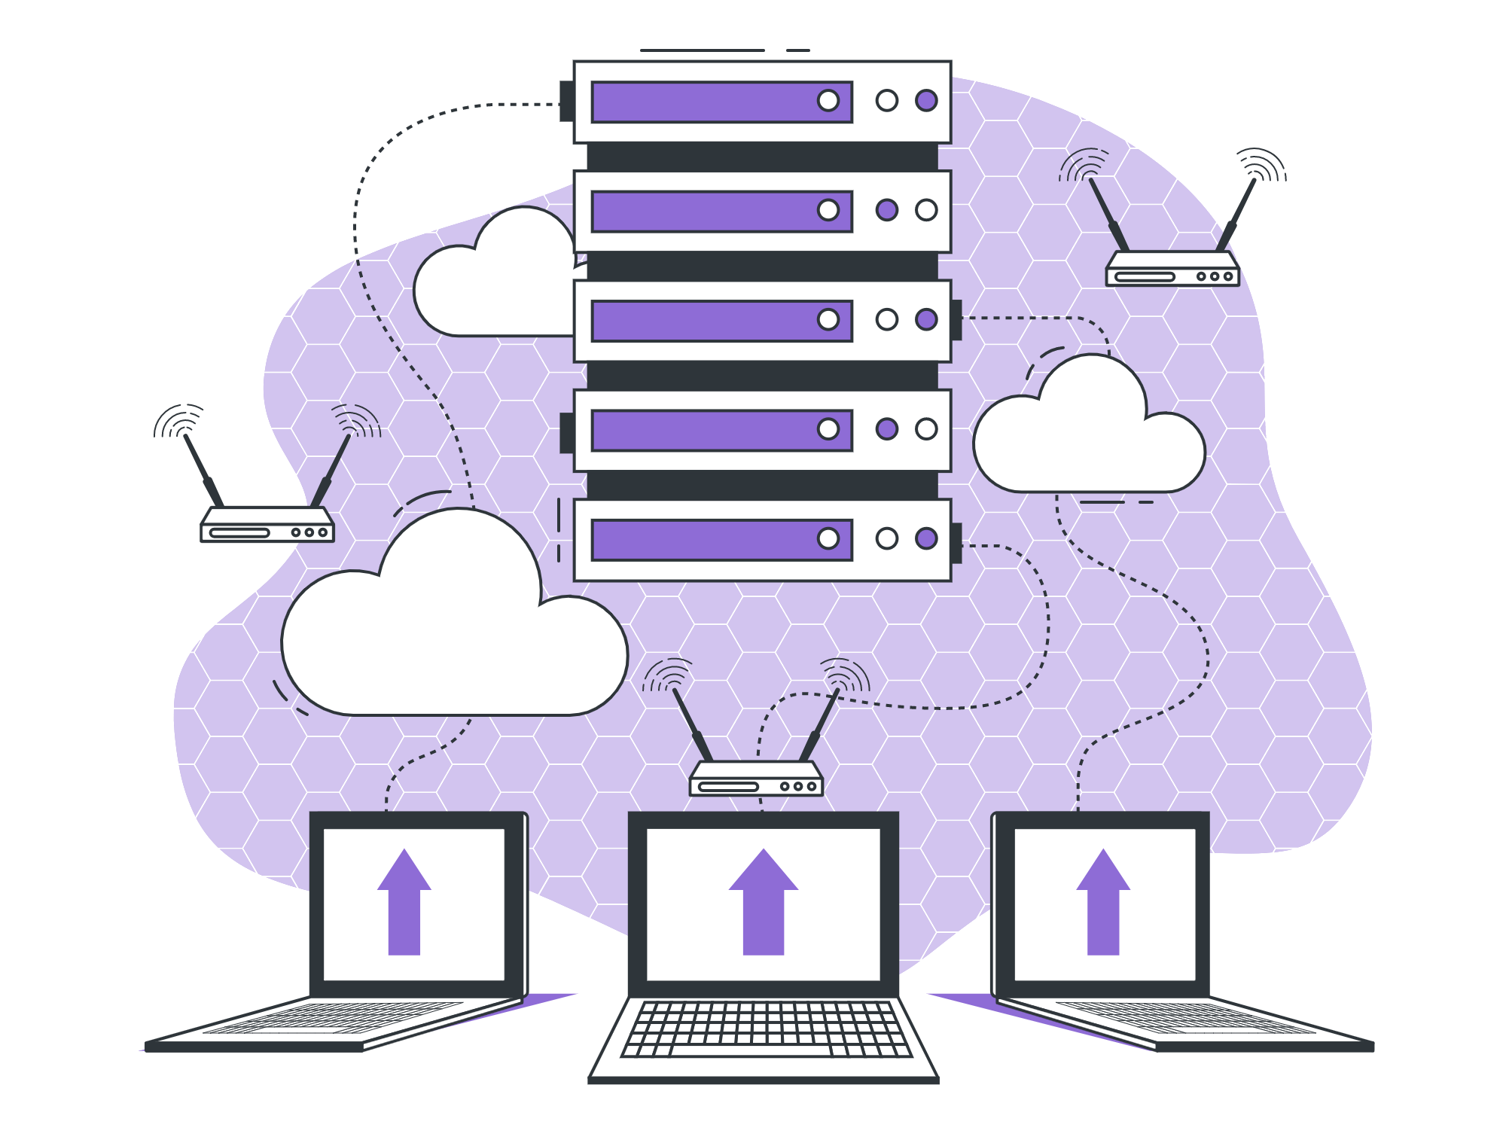
Join 1

Slide 2


List of Content
What and Why of a Join

Slide 3

What is a Join?
What and Why of a Join

Slide 4
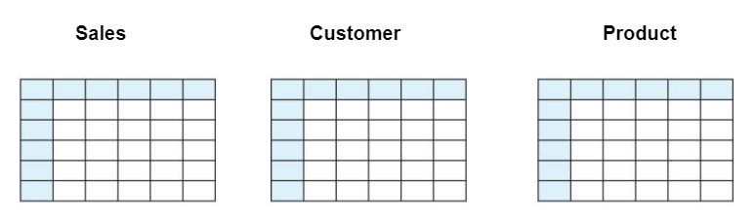
Why do we need Join ?
Suppose you want to understand/ fetch the data/report for customers in the age group of 25-30 years. For instance, what is the amount of sales and what is the hottest item on sale today in this age group.

Slide 5
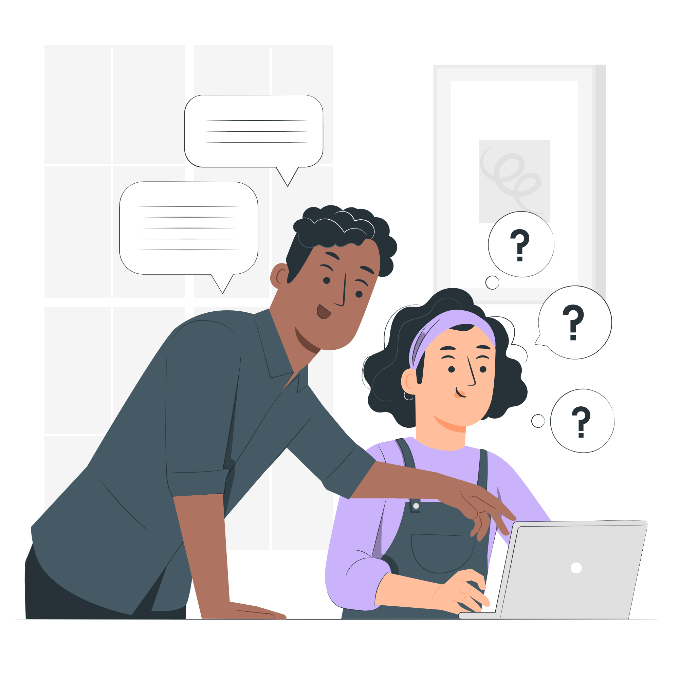
Why should you learn the concept ?
In the future or currently, if you are working with a firm that uses the concept of RDBMS, you should definitely know the concept of Joins.

Slide 6
THANK YOU

